Slide 1

Early Prediction in Student Programming Processes
MACS Research Project

Slide 2
Introduction
Computational thinking a problem-solving strategy that expresses problems and their solutions such that computer could execute.
Continuous formative assessments of K-12 students can improve the students understanding of the concepts.
Students perform programming tasks while editing source code, compiling and verifying solutions.
In doing so, sequence of program snapshots may be collected and analyzed in real-time for the purposes of tailoring instruction.
Notes:
The educational system has evolved from fact-based learning to problem solving based learning. Students are inclining towards innovation and creativity. Thus, a large influx of students is seen in computer programming in which the computational thinking is the main foundation. Let us understand first what exactly computational thinking means. It is defined as a problem solving strategy that involves expressing problems and their solutions such that computer could execute. It requires student to understand the given set of problem statement and generate the solution in computer programming language. Now, providing the students with the timely feedback for their solutions can improve the student understanding of the concepts. This can be done by analysing the intermediate steps of the student generated solutions. The sequence of programming snapshots may be collected and analysed in real time for the purposes of tailoring instruction.

Slide 3
Outline
Research Background
Research goals and Questions
Dataset
Experiments and Results.
Discussions
Q & A
Notes:
The outline of the presentation is as follows. The points that are going to be covered in this presentation are.

Slide 4
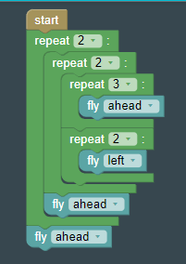
Research Background
Block
More legible, easing the burden to recall commands or syntax, as well as typing commands (Kolling et al., 2015; Kolling and McKay, 2016; Weintrop and Wilensky, 2015b).
Unfavorable habits - incorrect usages of programming structures and series of fine-grained commands rather than abstractions such as loops (Meerbaum-Salant et al., 2011).
In a comparison of both environments, Weintrop and Wilensky (2015a) has shown that students perform better on block-based questions related to conditional logic, function calls, and definite loops
Greater learning gains and higher levels of interest in future computing courses (Weintrop and Wilensky, 2017)
Complete activities in less amount of time (Price and Barnes, 2015)
Text
repeat 2:
repeat 2:
repeat 3:
fly()
repeat 2:
left()
fly()
fly()
Notes:
The research is focussed in improving the students understanding of the programming languages. Text- based programming languages require students to recall and type the commands. Also, studies have shown that students makes incorrect usages of the fine grained commands instead that can be done through abstractions such as loops. To overcome the limitations and develop the better understanding of the concepts Weintrop and Wilensky has shown that students performed better on block based questions related to condtional logic, functions calls and loops. Higher perfomance results in better task completion satisfaction and students are motivated to take more interest in the future computing courses. Also, the visual programming requires students to focus on logics rather then syntax. Thus, the students can complete the activities in less amount of time.

Slide 5
Research Goals and Questions
The aim of this study is to evaluate a classification model in terms of early prediction of student performance in block-based learning environments
The classification model is evaluated using a resampling method while varying data preprocessing steps, namely, the type of feature extraction and window segmentation to analyze intermediate edits to programs
Goodness of fit metrics estimated include Recall, F1, and Lift scores at each iteration of the resampling procedure where different examples are partitioned to the training and test set to allow for statistical comparison
The target attribute is the correctness of student programs at the last execution during the learning session
Notes:
The aim of our study is to evaluate a classification model which makes the early prediction of the student performance in block based learning environments. For data preparation, a resampling method is accompanied which include feature extraction and window segmentation of various sizes to analyse the intermediate edits to the program. For evaluating the goodness of fit metric the parameters that were considered for it was Recall, F1 score and lift metric. The data set was partitioned to training and test set and the model evaluated and various statistical comparisons were performed. The target is to generate the model which measures the correctness of student programs at the last execution of the learning session.

Slide 6
Dataset
The Blockly Programming Dataset (Effenberger, 2019) has been used to investigate learner modeling approaches in the context of learning programming in a block-based environment.
The dataset was chosen for its large number of tasks that capture different program behavior such as commands, loops, and conditions
A total of 85 tasks are divided into linearly and nominally ordered hierarchical problem sets (9 levels, each with 3 sublevels).
The data collected by the system consists of student interactions as well as the program states while editing and executing the task solution.
Notes:
The research has been carried out on Effenbergers Blockly Programming Dataset to investigate the learners modelling approaches in context of learning programming in block based learning environment. The dataset was chosen because of its diverse inclusion of tasks that covers various programming behaviours such as commands, loops and conditions. The dataset includes 85 tasks which further includes 9 levels with each 3 sublevels. The dataset includes the programming states of task execution and edition of the task solutions. Thus the dataset is large enough for the model to be trained and evaluated.

Slide 7
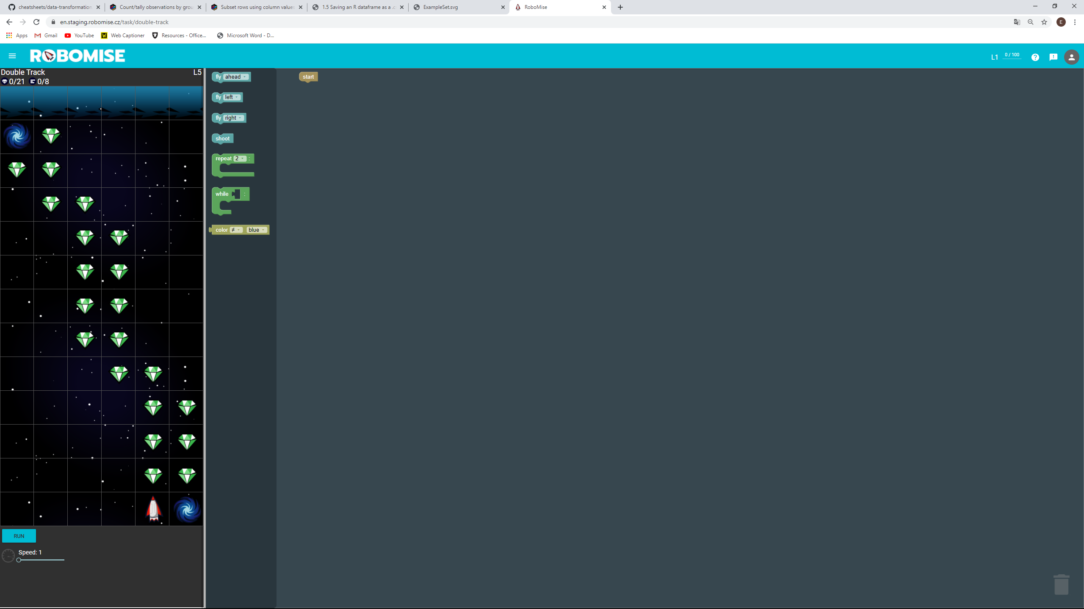
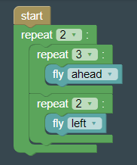
Computer-Based Learning Environment
Problem description
Given blocks
Correct solution
Most common error solution
Effenberger, T., & Pelánek, R. (2018, June). Towards making block-based programming activities adaptive. In Proceedings of the Fifth Annual ACM Conference on Learning at Scale (pp. 1-4).
Notes:
Here is the problem in which the user should collect all the diamonds in the path between the starting and endpoint. There is a blackhole from which the spaceship can go in one and come out from another. These are the given blocks that need to be arranged such that mission is successful. Explain the looping condition.

Slide 8
Method
Blocks (Blockly)
Text (Python-like)
Text (Compact)
repeat 2:
repeat 2:
repeat 3:
fly()
repeat 2:
left()
fly()
fly()
R2{R2{R3{f}R2{l}}f}f
Code editor for students
Sample solutions in task sources
Logging, storing in database, analysis
Effenberger, T., & Pelánek, R. (2018, June). Towards making block-based programming activities adaptive. In Proceedings of the Fifth Annual ACM Conference on Learning at Scale (pp. 1-4).
Notes:
This is the sample solution that is generated in text format and its compact form that is included in the data set. The compact form of the solution is used to train the dataset.

Slide 9
Experiment #1 Feature Extraction
Table 1. Encoding approaches used for parsing and level of granularity for each edit in a windowed segment
Gram | Encoding
 | Character | Semantic
Uni | R2{} | R2{f} | … | R2{} | R2{f} | …
Bi | R2{} | R2{f} | … | R2{} | R2{f} | …
Tri | R2{} | R2{f} | … | R2{} | R2{f} | …
Note. While semantic encoding characterizes meaningful units of information (i.e., R2, as in repeat two times loop statement), character encoding captures the textual character (i.e., R or the first character in the string segment). An increasing amount of combinations of either characters or semantic information can be encoded, ranging from one, two, or three sequences of characters (i.e., [ R, 2, { ]) or meaningful units (i.e., [ R2, {}, R2]). A 3-gram sequence would then be represented as either “R_2_{“ for characters or “R2_{}_R2” for semantic units and weighed on the basis of its frequency of occurrence on a continuous scale ranging from 0, 1, …, ∞, where each edit in the windowed segment is separated by “|”.
Notes:
The data preparation for the model is done by two types of Encoding techniques. One is the normal n-gram technique in which the sequential characters as shown the table is extracted . But the method is little imprecise and tokens that are generated are less meaningful for the model. To generate the tokens that are more meaningful for the model a custom parser was made which extracted meaningful units as R2 which means repeat the loop two times, f meaning forward, l meaning left and soon.

Slide 10
Experiment #1 Results
Table 2. Goodness of fit metric estimates on resampling by type of encoding for parsing and level of granularity
Metric | Character Encoding |  |  | Semantic Encoding
 | Uni-Gram | Bi-Gram | Tri-Gram | Uni-Gram | Bi-Gram | Tri-Gram
Recall | .50 | .49 | .50 | .48 | .51 | .55*
F1 | .49 | .49 | .49 | .48 | .49 | .51*
Lift | 1.09 | 1.09 | 1.10 | 1.10 | 1.10 | 1.10
Note. 200 examples per paired samples in each condition, controlling for non-overlapping fixed window step (n = 10) and seed for 5-fold stratified cross-validation (n = 20) as confounding factors. *Paired-sample two-sided t-test with bonferroni correction, p < .005.
Notes:
the model was trained and the results obtained for the following experiment is as follows. The Recall, F1 and lift metric was used to evaluate the model performance. Explain the Recall, F1 and Lift metric.
Recall: It is the measure of how many examples that wanted to be captured for a particular class i.e positive or negative where actually captured. The formula for the recall is True positive/ true positive + false negative
F1 score: It indicates the balance between precision and Recall that in turn is indicative of imbalance in the dataset its formula is 2PR /P+R.
Lift: Lift is a measure of the performance of a targeting model at predicting or classifying cases as having an enhanced response

Slide 11
Experiment #1 Results
d = 0.44 (p < .005)
.50
.55
Note. 200 examples per paired samples in each condition, controlling for non-overlapping fixed window step (n = 10) and seed for 5-fold stratified cross-validation (n = 20) as confounding factors. *Paired-sample two-sided t-test with bonferroni correction, p < .005.
Notes:
Comparing the model performance results of character encoding and semantic encoding. We found that semantic encoding performed better than character encoding and showed better recall and F1 score. The recall value for character trigram encoding was .5 and for semantic encoding was .55. Paired sample t–test comparison was performed for semantically and character encoded dataset with Bonferroni correction threshold value of less than 0.005. Here value of d indicates the how much separated are the recall values for character and semantic encoding . Here the value of d is division of differences of mean with the standard deviation. As it is evident from the graph that is plotted. X axis denotes the difference of t test for character and semantic encoding versus the number of iterations for 200 data points. The distribution is more concentrated on the top which denotes semantic encoding outperforms the character encoding.

Slide 12
Experiment #1 Results
d = 0.23 (p < .005)
.49
.51
Note. 200 examples per paired samples in each condition, controlling for non-overlapping fixed window step (n = 10) and seed for 5-fold stratified cross-validation (n = 20) as confounding factors. *Paired-sample two-sided t-test with bonferroni correction, p < .005.
Notes:
Similar trend was observed in f1 score. Semantic encoding outperformed the charachter encoding.

Slide 13
Experiment #2 Segmentation Window
Table 3. Window sizes used for 3-gram semantic encoding and order of edit in each windowed segment
Step | Window Size
 | 5 Edits | 10 Edits
5th | ________________________________ | _________________________________
15th | ________________________________ | _________________________________
25th | ________________________________ | _________________________________
Note. While larger window sizes results in concatenating a larger amount of edits for the purposes of encoding contiguous sequences of meaningful units (i.e., a total of 10 edits), smaller window sizes capture lesser amounts of edits (i.e., a total of 5 edits). An increasing order of edits can be used to determine where segmentation occurs within a sequence, ranging from the 5th, 15th, and 25th edit in the sequence.
Notes:
In Experiment 2 the model was trained for the for two different window sizes. First window size included the concatenation of 5 contiguous edits that was made during the program execution. The window size for the first experiment was 5 and for another was 10. i.e the 5 to 10 th edit, 15th to 20th edit and soon was concatenated while in the other case 5th to 15th edit then 15th to 25th edit and soon was concatenated. Comparing the model performance the following results was obtained.

Slide 14
Experiment #2 Results
Table 4. Goodness of fit metric estimates on resampling by type of segmentation window size and step
Metric | 5 Edits |  |  | 10 Edits
 | 5th | 15th | 25th | 5th | 15th | 25th
Recall | .57 | .55 | .44 | .63* | .59* | .56*
F1 | .52 | .52 | .43 | .56* | .53* | .49*
Lift | 1.10* | 1.11 | 1.13* | 1.08 | 1.10 | 1.05
Note. 200 examples per paired samples in each condition, controlling for seed of the 5-fold stratified cross-validation (n = 200) as a confounding factor. *Significant paired-sample two-sided t-test with bonferroni correction, p < .005.
Notes:
Significant increase in the recall and F1 value was observed in all the edits as it is evident in the table. Seeing the trend an increase was observed in Recall and F1 score while the lift score saw a decrease in its value.

Slide 15
Experiment #2 Results
d = 0.59 (p < .005)
.57
.63
Note. 200 examples per paired samples in each condition, controlling for seed for 5-fold stratified cross-validation (n = 200) as confounding factors using 3 n-gram semantic encoding approach. *Paired-sample two-sided t-test with bonferroni correction, p < .005.
Notes:
As you can see the cohen value for the graph was .59 while considering the 10 contiguous edit sequence as compared to 5 contiguous edit sequence.

Slide 16
Experiment #2 Results
d = 0.63 (p < .005)
.52
.56
Note. 200 examples per paired samples in each condition, controlling for seed for 5-fold stratified cross-validation (n = 200) as confounding factors using 3 n-gram semantic encoding approach. *Paired-sample two-sided t-test with bonferroni correction, p < .005.
Notes:
Explain the graphs

Slide 17
Experiment #2 Results
d = 0.57 (p < .005)
1.10
1.08
Note. 200 examples per paired samples in each condition, controlling for seed for 5-fold stratified cross-validation (n = 200) as confounding factors using 3 n-gram semantic encoding approach. *Paired-sample two-sided t-test with bonferroni correction, p < .005.
Notes:
The lift value for the graph showed inverse trend as compared to recall and f1 score. The lift score suffered and drop was observed in all the edit sequences. The graph also depicts the similar trend.

Slide 18
Experiment #3 Model Evaluation
For each iteration of the resampling procedure, the random seed used for partitioning in a 5-fold stratified cross-validation in experiment #1 and experiment #2.
The resulting model that includes the parameters retained in experiment #1 and #2 was evaluated using a leave-one-out cross-validation procedure.
We examine the confusion matrix and discuss the validity of the model by interpreting the different branching scenarios
Notes:
The leave-one-out of cross validation procedure was used for model evaluation where a single learning session was used for the testing and remaining was used for training. In the resampling procedure a random seed was used for cross-validation. In each iteration so that the experiment can be repeated for the same seed value. For the model evaluation, the sequence of edits that occurred during the learning session at the 5th edit, including a total of 10 edits are concatenated for the purposes of extracting contiguous sequences of a maximum of 3 semantic units. The confusion matrix is used for validating the model and interpreting various branch scenarios.

Slide 19
Experiment #3 Results
Table 5. Confusion matrix for the early prediction of student-produced solution correctness at the last execution
Decision Tree Path to Early Prediction of “Correct”
R2_{_R3 > 1.500
| R2_{_f ≤ 0.500
| | R3 ≤ 10.500
| | | f_} ≤ 13.500
| | | | nan_ R2_{} ≤ 0.500: Correct [Incorrect = 7, Correct = 69]
Final Correct Solution
R2{R2{R3{f}R2{l}}f}f
Predicted | Observed
 | Incorrect | Correct
Incorrect | 176 | 127
Correct | 35 | 106
Notes:
The following denotes the Experiment 3 confusion matrix and Decision tree path for the correct solution. It can be seen that the model is more accurately able to identify the incorrect solutions While the model struggles for classifying the correct solution. The figure denotes decision tree for the Final correct solution. If the edits done by the user contains more number of R2 { R3 character. And has threshold value greater than 1.5 it is likely that the student is advancing for the correct solution. Similary for the rest of solution path.

Slide 20
Discussion
Model is able to accurately detect 4 out of 5 incorrect solutions produced by students at the last execution during a learning session (recall = 83.41%).
The early prediction model is not precise, as 3 out of 5 solutions that are predicted as incorrect, were in fact later found to be correctly solved by the students (precision = 58.09%).
These findings suggest that students who need assistance are likely to receive it as a result of the early prediction made by the model.
However, those that do not require any form of assistance may be presented with instructional content that is not necessary to improve learning and performance.
Notes:
Considering the recall value of the observed and predicted value of the incorrect solutions. A good recall score of approximately of 84% percent was observed. Thus the model is accurately able to detect the 4 out of 5 incorrect solutions produced by the students. However the model has the limitation in the early prediction as 3 out of 5 solutions that are predicted as incorrect, were in fact later found to be correctly solved by the students (precision = 58.09%). This states that the students who need the assistance will likely receive the early prediction that is made by the model. However those who do not require any form of assistance may be given the instructional content that is not necessary.

Slide 21

Q&A

